Slide 1
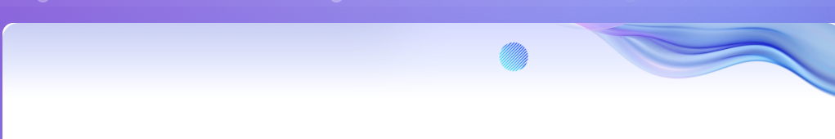
Hashtag Analyzer Analyzing trends from user-generated text and hashtags
Devi Senthilkumar

Slide 2
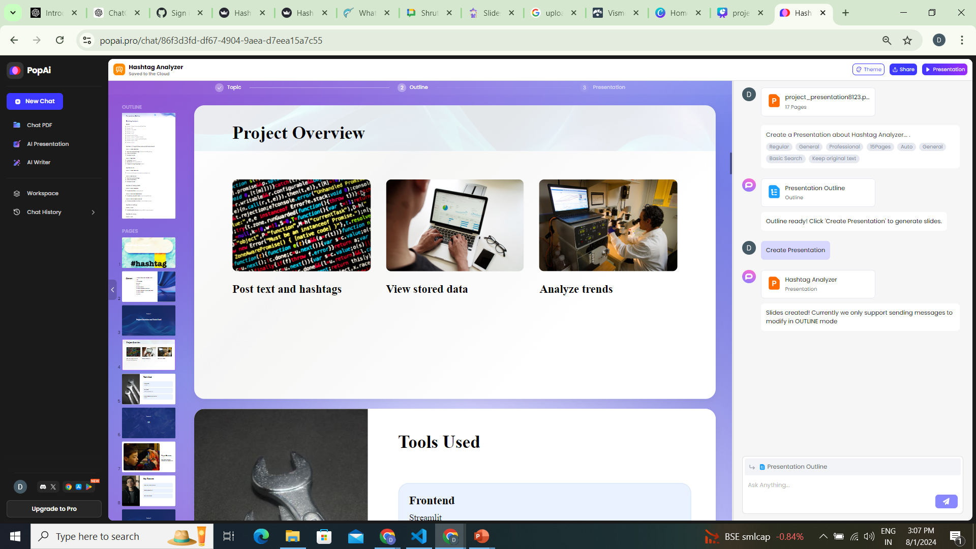

Slide 3
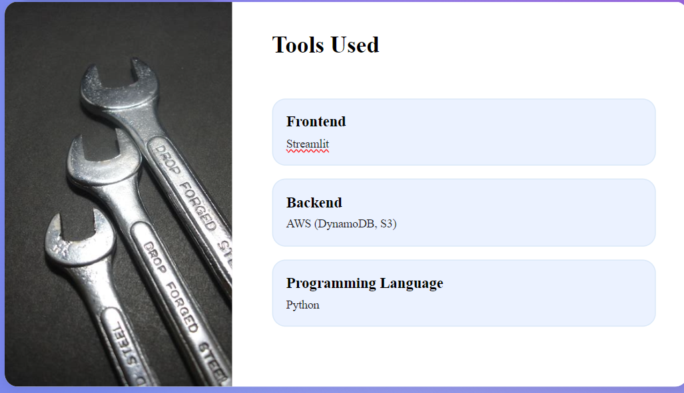
Lambda,DynamoDB

Slide 4
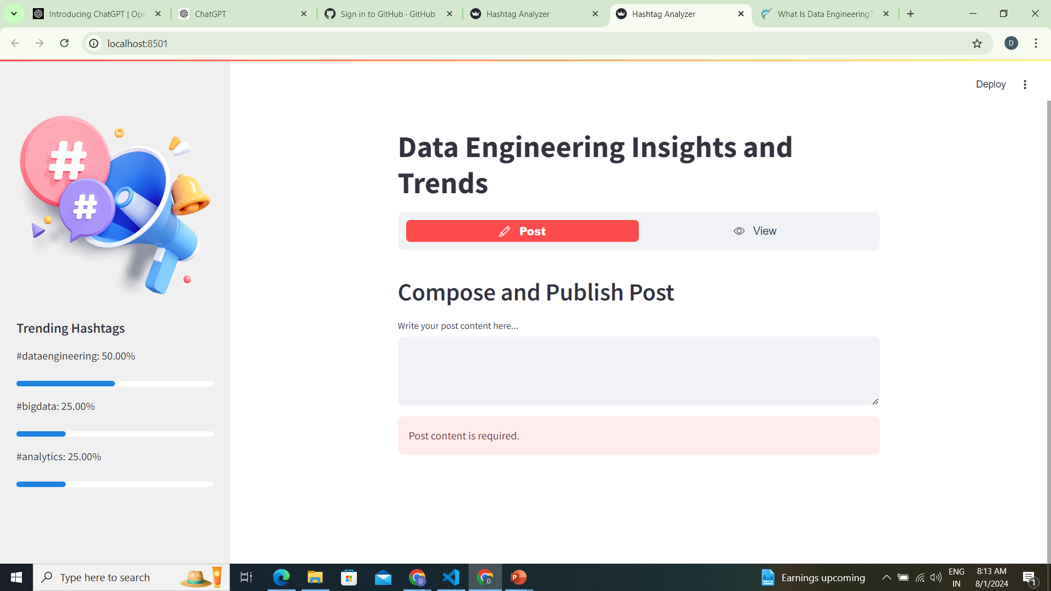
UI

Slide 5
Code Walkthrough
Install AWS CLI: & Configure the AWS Profile:
Setup_aws
app.py
Install AWS CLI
Install AWS CLI: Ensure the AWS CLI is installed on your system.
Configure the AWS Profile: Use aws configure --profile your_profile_name to set up your profile.
Verify the Profile: Use aws configure list-profiles to check your profiles.
Use the Profile in Code: Initialize a boto3.Session with the profile name and use it to create the client.
This approach helps you manage multiple sets of credentials securely and conveniently.

Slide 6
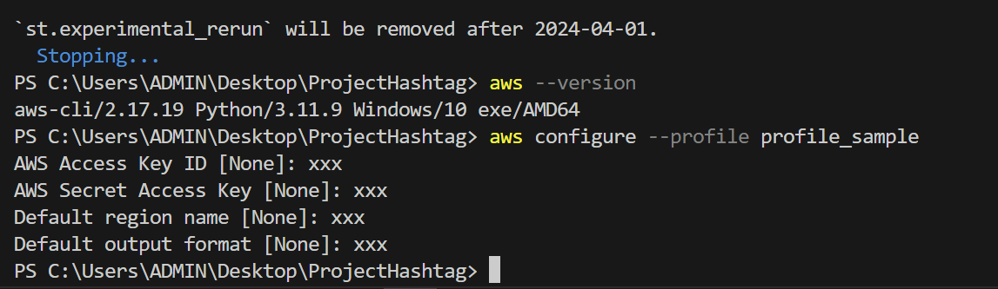
Configure the AWS Profile:
set up the AWS CLI and configure the profile.
1.aws --version 2.Download and run the AWS CLI MSI installer for Windows (64-bit): https://awscli.amazonaws.com/AWSCLIV2.msi Alternatively, you can run the msiexec command to run the MSI installer.
C:\> msiexec.exe /i https://awscli.amazonaws.com/AWSCLIV2.msi
2. aws configure --profile your_profile_name
Enter your AWS credentials and configuration. You'll be prompted to enter:
AWS Access Key ID
AWS Secret Access Key
Default region name (e.g., us-east-1)
Default output format (e.g., json)

Slide 7
Obtaining AWS Credentials
Sign in to the AWS Management Console:
Go to the AWS Management Console and sign in with your AWS account credentials.
Navigate to the IAM Console:
From the AWS Management Console, navigate to the IAM (Identity and Access Management) service. You can find it by searching for "IAM" in the AWS services search bar.
Create or Select a User:
In the IAM console, go to Users. You can either create a new user or select an existing user.
Create Access Keys:
If you're creating a new user, ensure you enable programmatic access (this creates an access key). If you’re using an existing user:
Click on the username.
Go to the Security credentials tab.
Scroll down to the Access keys section and click Create access key.
You’ll see a pop-up with your new Access Key ID and Secret Access Key. Make sure to download or copy these credentials immediately as the secret key will not be shown again.

Slide 8
Zip file creation for creating AWS Lambda using CLI
lambda_function.py: Contains the main Lambda function code.
helper_module.py: Contains additional helper functions.
requirements.txt: Lists Python dependencies.
Projectfolder ->
mkdir my_lambda_function
cp lambda_function.py helper_module.py requirements.txt my_lambda_function/
Projectfolder ->my_lambda_function
pip install -r my_lambda_function/requirements.txt -t my_lambda_function/
Projectfolder ->my_lambda_function
tar -a -c -f my_lambda_function.zip *

Slide 9
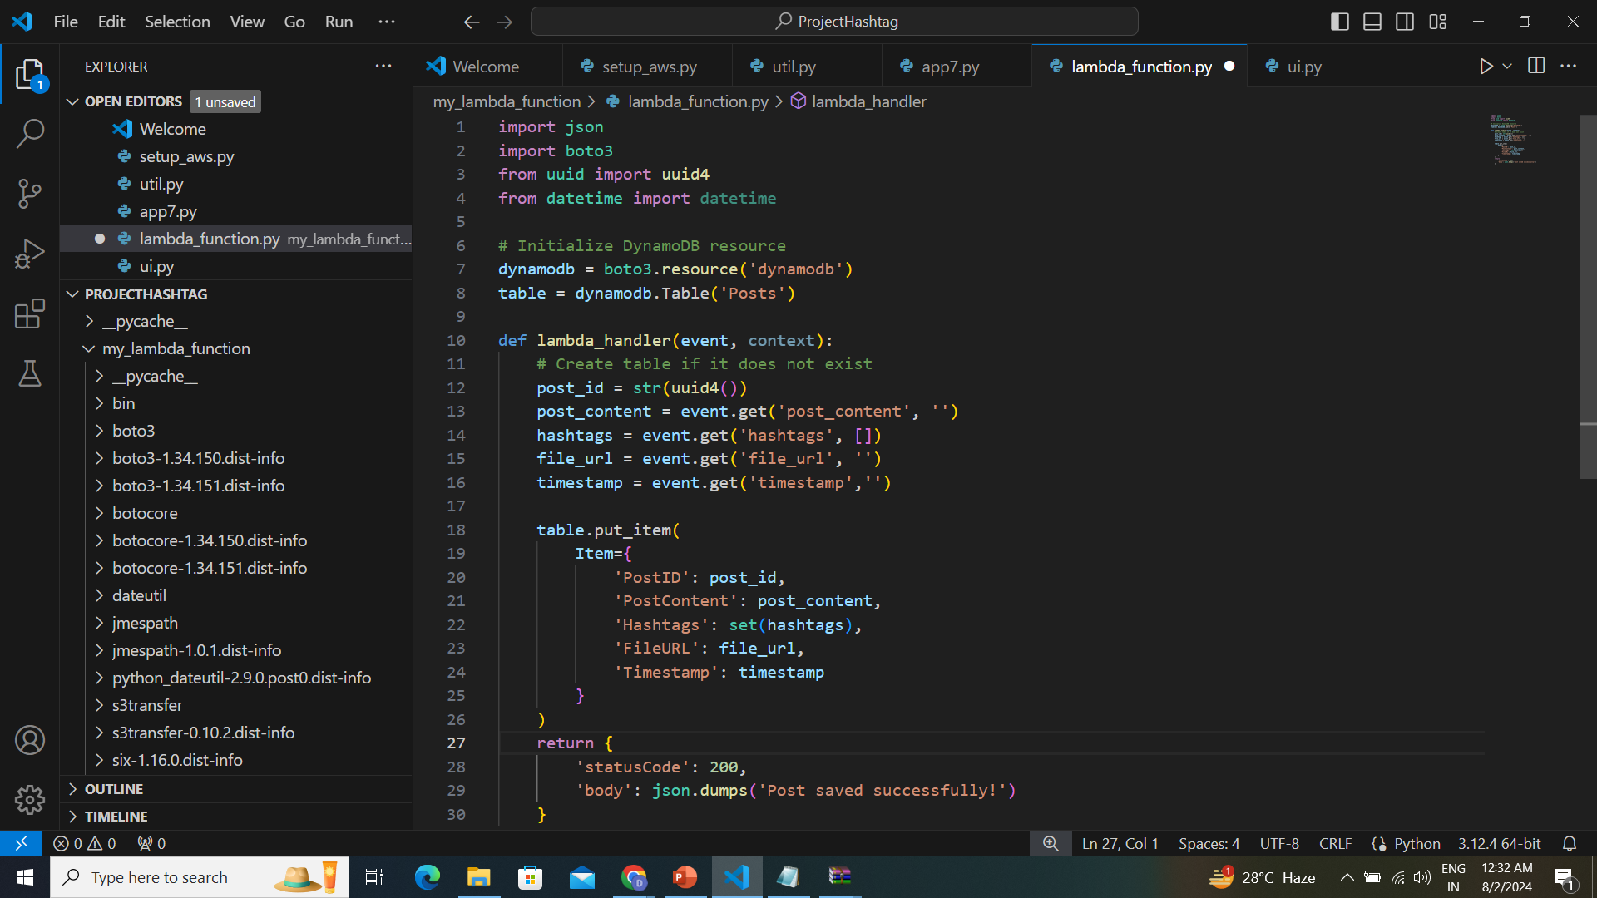
lambda_function.py

Slide 10
Setup_aws.py
import boto3
import json
from botocore.exceptions import ClientError
def main():
role_arn = create_iam_role() # Create IAM role
if role_arn:# Create DynamoDB table
create_dynamodb_table()# Create Lambda function
create_lambda_function(role_arn)

Slide 11
Create Lambda Function
def create_lambda_function(role_arn):
try:
response = lambda_client.create_function(
FunctionName=lambda_function_name,
Runtime='python3.8',
Role=role_arn,
Handler='lambda_function.lambda_handler',
Code={'ZipFile': open(lambda_zip_file, 'rb').read()},
Description='Lambda function for hashtag analysis',
Timeout=30,
MemorySize=128
)
print(f"Lambda function created: {lambda_function_name}")
print("Function ARN:", response['FunctionArn'])
except ClientError as e:
print(f"Error creating Lambda function: {e}")
if __name__ == "__main__":
main()

Slide 12
Create IAM Role
def create_iam_role():# Create IAM Role
try:
assume_role_policy = {
"Version": "2012-10-17",
"Statement": [ {
"Effect": "Allow",
"Principal": {"Service": "lambda.amazonaws.com"},
"Action": "sts:AssumeRole" }]}
role = iam_client.create_role(RoleName=role_name, # Create role
AssumeRolePolicyDocument=json.dumps(assume_role_policy) )
print(f"Role created: {role_name}")
# Attach policies
iam_client.attach_role_policy(
RoleName=role_name,
PolicyArn='arn:aws:iam::aws:policy/AWSLambda_FullAccess')
iam_client.attach_role_policy(
RoleName=role_name,
PolicyArn='arn:aws:iam::aws:policy/AmazonDynamoDBFullAccess')
print(f"Policies attached to role: {role_name}")
return role['Role']['Arn']

Slide 13
Create DynamoDB Table
# Create DynamoDB Table
def create_dynamodb_table():
try:
table = dynamodb.create_table(
TableName=dynamodb_table_name,
KeySchema=[{'AttributeName': 'PostID', 'KeyType': 'HASH'}],
AttributeDefinitions=[{'AttributeName': 'PostID', 'AttributeType': 'S'}],
ProvisionedThroughput={'ReadCapacityUnits': 5,'WriteCapacityUnits': 5})
table.meta.client.get_waiter('table_exists’)
.wait(TableName=dynamodb_table_name)
print(f"DynamoDB table created: {dynamodb_table_name}")
except ClientError as e:
print(f"Error creating DynamoDB table: {e}")

Slide 14
util.py
import boto3
def initialize_aws_clients(): # Initialize AWS clients with profile
session =
boto3.Session(profile_name=aws_profile,region_name=aws_region)
dynamodb = session.resource('dynamodb')
table = dynamodb.Table(dynamodb_table_name)
iam_client = session.client('iam’)
lambda_client = session.client('lambda’)
return dynamodb, table , iam_client , lambda_client
# AWS configuration
aws_profile = 'devi_profile' # Name of the profile configured with aws configure
aws_region = 'us-east-1'
role_name = 'MyLambdaDynamoDBRole'
lambda_function_name = 'MyHashtagFunction'
dynamodb_table_name = 'Posts'
lambda_zip_file = 'function.zip'

Slide 15
app.py – Part1
import streamlit as st
import boto3
from uuid import uuid4
from datetime import datetime, timezone, timedelta
from botocore.exceptions import ClientError
from streamlit_option_menu import option_menu # For navigation menu
import ui
import util as ut
dynamodb, table = ut.initialize_aws_clients()
# Set page config first
st.set_page_config(page_title="Hashtag Analyzer", page_icon="")
ui.apply_ui()
st.sidebar.image("C://Users//ADMIN//Desktop//GUVI//HTimg.png", use_column_width=True)
st.title("Data Engineering Insights and Trends")

Slide 16
app.py – main()
# Main page navigation
def main():
display_trending_hashtags()
menu = option_menu(
menu_title=None,
options=["Post", "View"],
icons=["pencil", "eye"],
default_index=0,
orientation="horizontal",
)
if menu == "Post":
post_content_page()
elif menu == "View":
view_post_page()

Slide 17
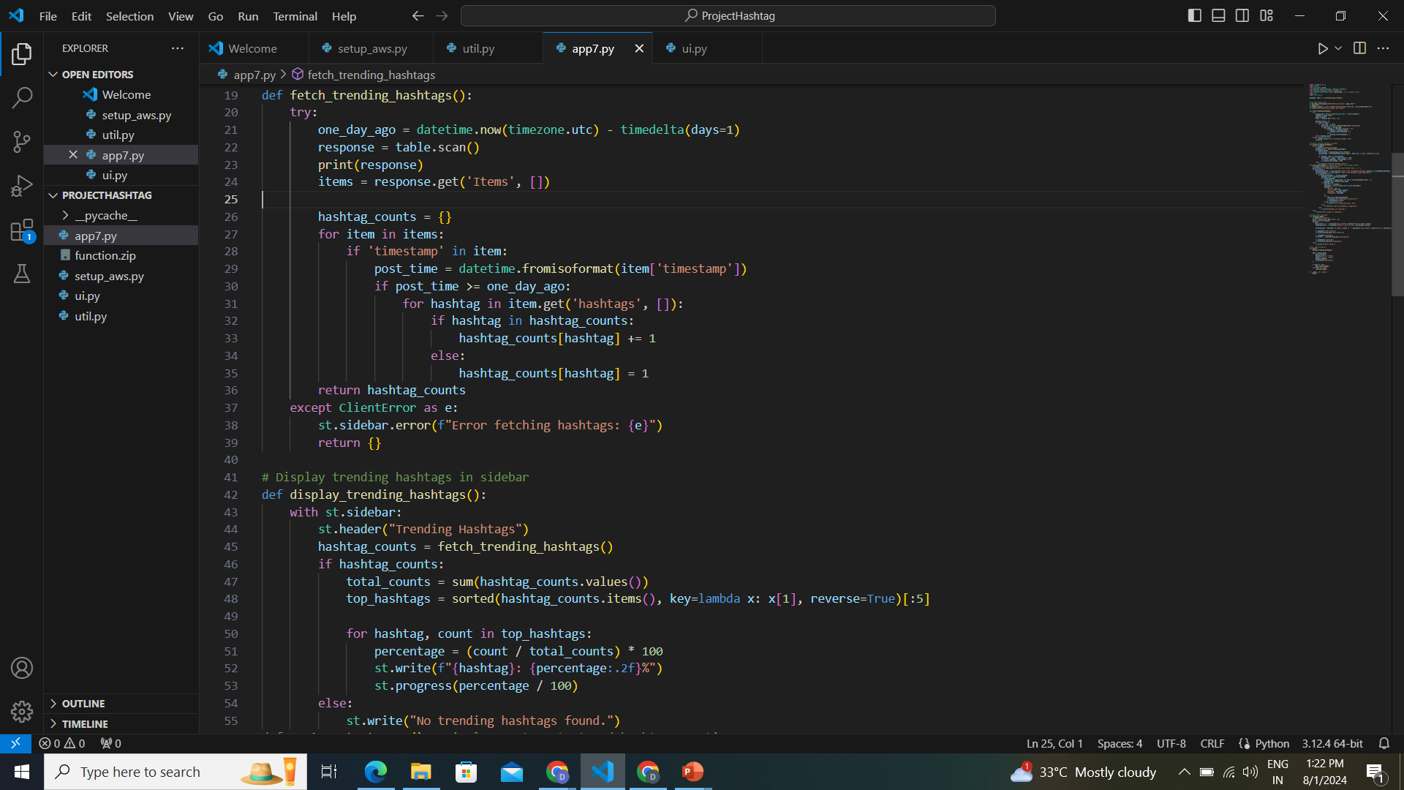
app.py -Trending - Display

Slide 18
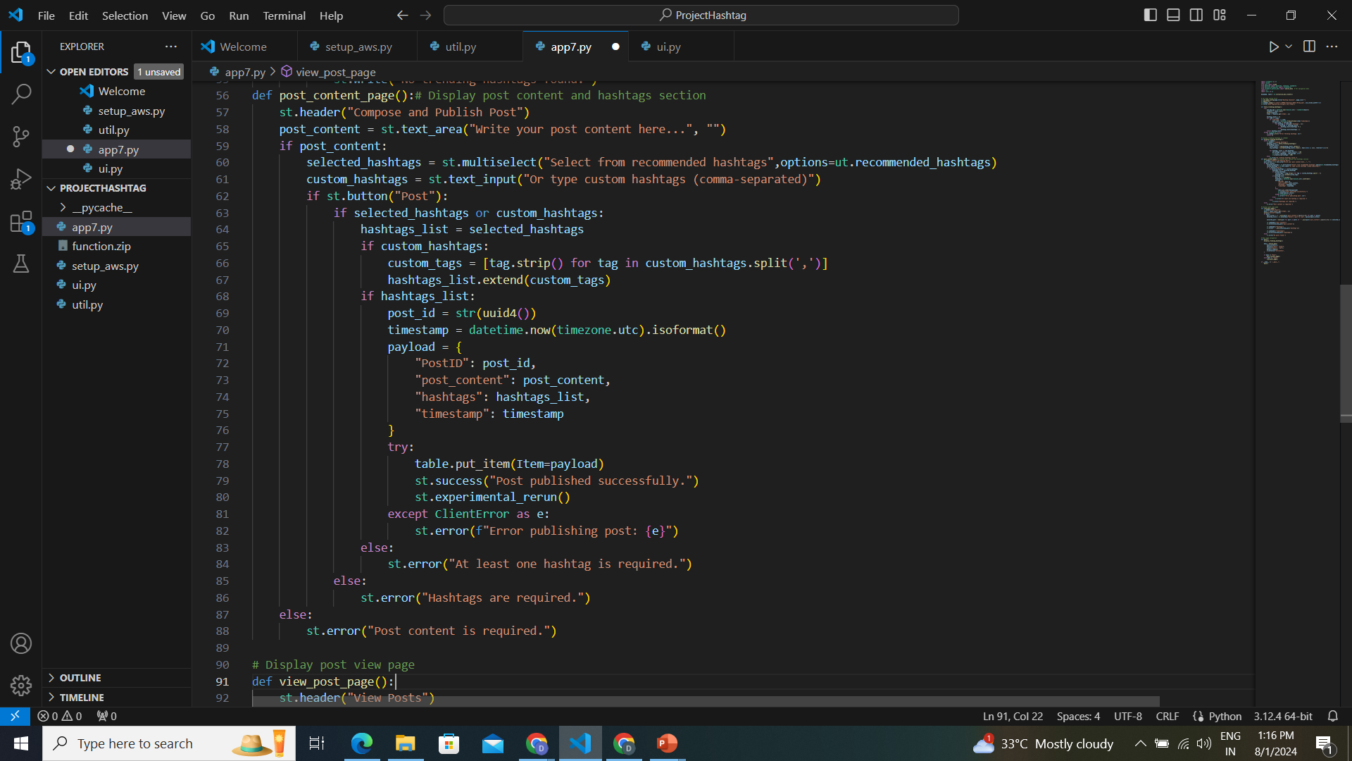
app.py - Content and HashTag-Post

Slide 19
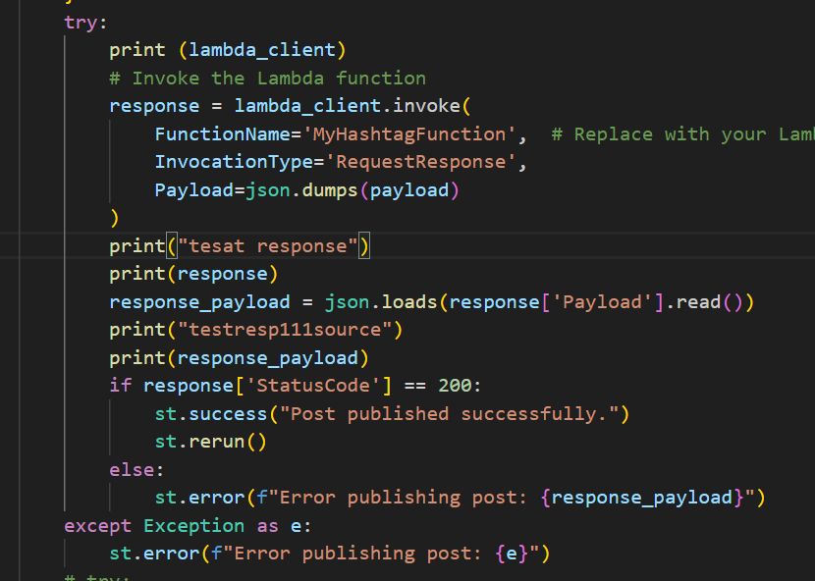

Slide 20
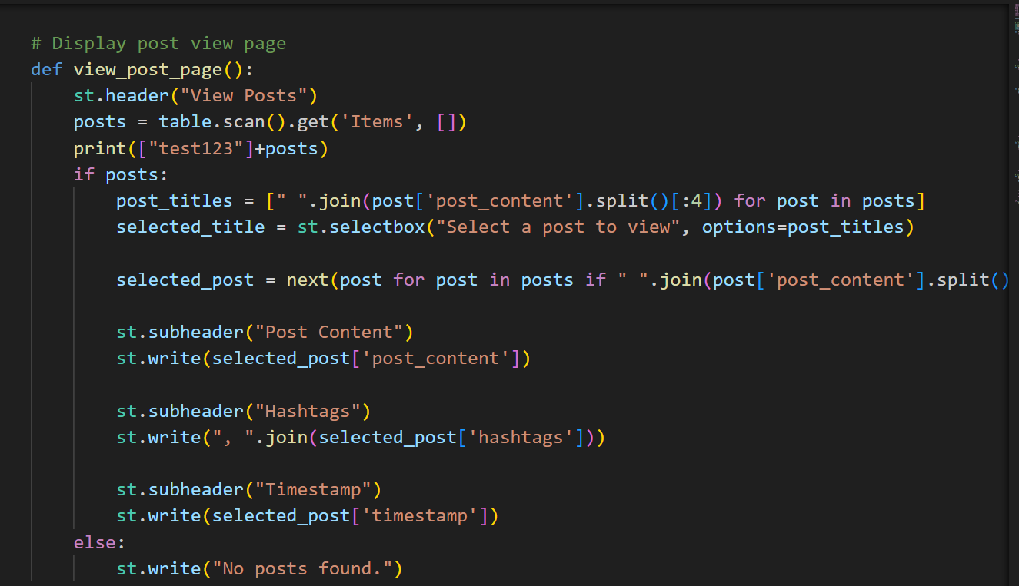
app.py - View

Slide 21
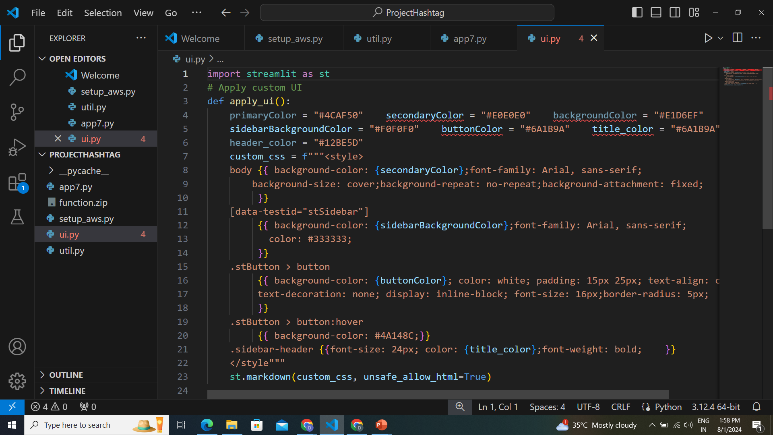
Ui.py

Slide 22
Thank You

